Slide 1
UNIT- III
Bitcoins and Alternative Coins
20CSE15- BLOCKCHAIN TECHNOLOGIES

Slide 2
Bitcoins and Alternative Coins
Bitcoin – Transactions – Blockchain - Bitcoin payments - Alternative Coins - Theoretical foundations - Bitcoin limitations – Namecoin - Litecoin – Primecoin – Zcash - Smart Contracts.

Slide 3
Bitcoin
first application of blockchain technology.
In 2008, Bitcoin was introduced through a paper called, Bitcoin: A Peer-to-Peer Electronic Cash System (https://bitcoin.org/bitcoin.pdf)
The name of the Bitcoin inventor Satoshi Nakamoto is believed to be a pseudonym, as the true identity of Bitcoin inventor is unknown.
Bitcoin is built on decades of cryptographic research such as the research in Merkle trees, hash functions, public key cryptography, and digital signatures.
The key issue that has been addressed in Bitcoin is an elegant solution to the Byzantine Generals' Problem along with a practical solution of the doublespend problem.
https://coinmarketcap.com/currencies/bitcoin/

Slide 4
The original idea behind Bitcoin was to develop an e-cash system which requires no trusted third party and users can be Anonymous.
There are now many initiatives being taken to regulate Bitcoin, cryptocurrencies and related activities such as ICOs.
Securities and Exchange Commission (SEC) has recently announced that digital tokens, coins and relevant activities such as Initial Coin Offerings (ICOs) fall under the category of securities.
This means that any digital currency trading platforms will need to be registered with SEC and will have all relevant securities laws and regulations applicable to them. This impacted the Bitcoin price directly and it fell almost 10% on the day this announcement was made

Slide 5
The growth of Bitcoin is also due to so-called network effect.
Also called demand-side economies of scale, it is a concept that basically means more users who use the network, the more valuable it becomes.
The scarcity of Bitcoin and built-in inflation control mechanism gives it value as there are only 21 million bitcoins that can ever be mined and in addition the miner reward halves every four years.

Slide 6
Bitcoin definition
Bitcoin- it's a protocol, a digital currency, and a platform
It is a combination of peer-to-peer network, protocols, software that facilitate the creation and usage of the digital currency named bitcoin.
Nodes in this peer-to-peer network talk to each other using the Bitcoin protocol.

Slide 7
Double spending problem arises when, for example, a user sends coins to two different users at the same time and they are verified independently as valid transactions.
The double spending problem is resolved in Bitcoin by using a distributed ledger (blockchain) where every transaction is recorded permanently and by implementing transaction validation and confirmation mechanism (mining)

Slide 8
Bitcoin – a bird's-eye view
the main components of a Bitcoin network are
Digital keys
Addresses
Transactions
Blockchain
Miners
The Bitcoin network
Wallets (client software)

Slide 9
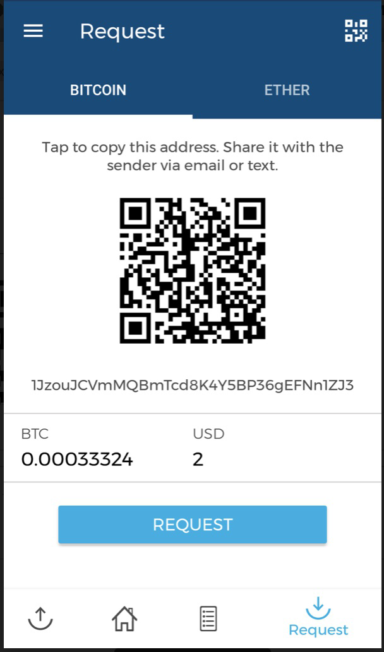
Sending a payment to someone
This example will demonstrate that how money can be sent using Bitcoin network from one user to another.
First, either the payment is requested from a user by sending his Bitcoin address to the sender via email or some other means
the Blockchain wallet is shown here where a payment request is
created

Slide 10
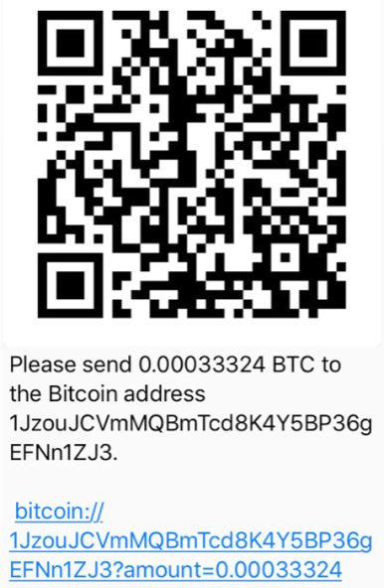
The sender either enters the receiver's address or scans the QR code that has the Bitcoin address, amount and optional description encoded in it. The wallet application recognizes this QR code and decodes it into something like Please send <Amount> BTC to the Bitcoin address <receiver's Bitcoin address>.
This will look like as shown here with values: Please send 0.00033324 BTC to the Bitcoin address 1JzouJCVmMQBmTcd8K4Y5BP36gEFNn1ZJ3.

Slide 11
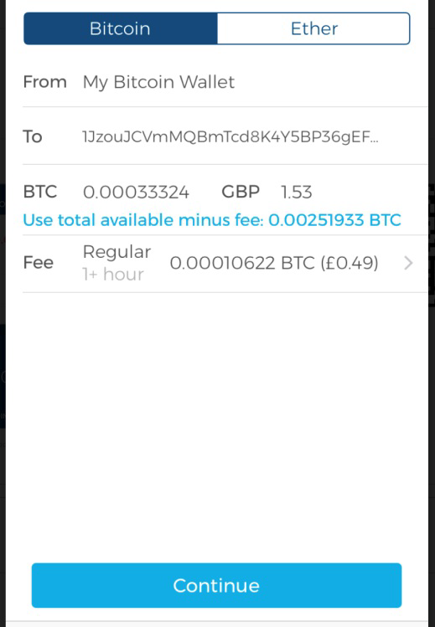
In the wallet application of the sender, this transaction is constructed by following some rules and broadcasted to the Bitcoin network.
This transaction is digitally signed using the private key of the sender before broadcasting it.

Slide 12
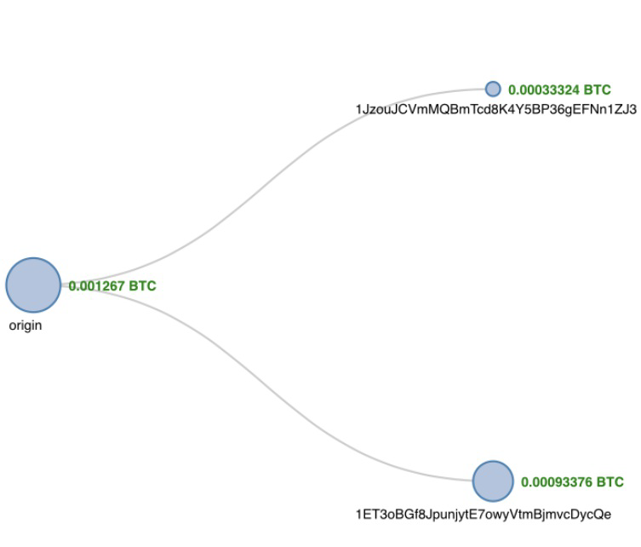
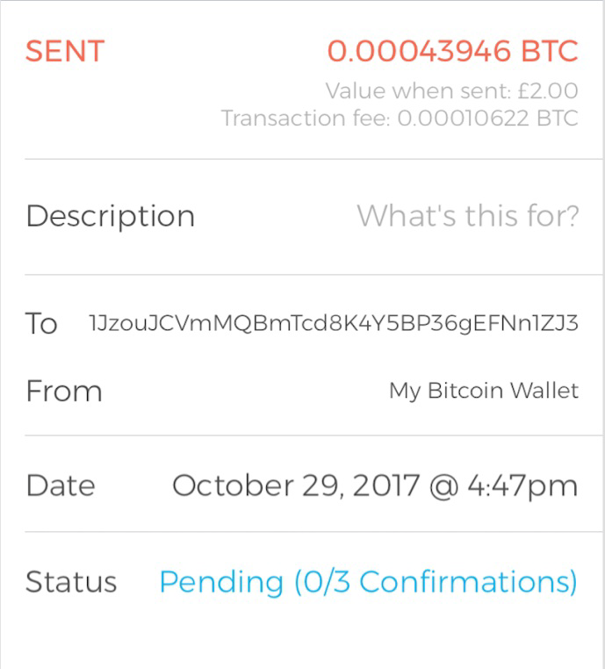

Slide 13
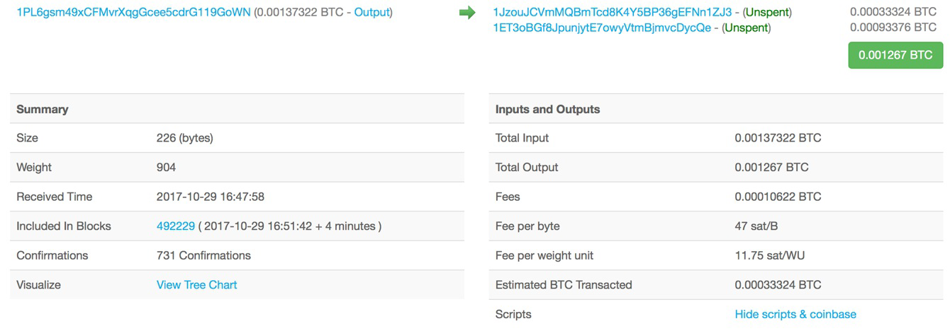
A summary view of various attributes of the transaction

Slide 14
Important fields
Size: This is the size of the transaction in bytes.
Weight: This is the new metric given for block and transaction size since the introduction of Segregated Witness (SegWit) version of Bitcoin.
Received Time: This is the time when the transaction is received.
Included In Blocks: This shows the block number on the blockchain in which the transaction is included.
Confirmations: This is the number of confirmations by miners for this transaction.
Total Input: This is the number of total inputs in the transaction.
Total Output: This is the number of total outputs in the transaction.
Fees: This is the total fees charged.
Fee per byte: This field represents the total fee divided by the number of bytes in a transaction. For example 10 Satoshis per byte.
Fee per weight unit: For legacy transaction it is calculated using total number of bytes * 4. For SegWit transactions it is calculated by combining SegWit marker, flag, and witness field as one weight unit and each byte of other fields as four weight units.

Slide 15
Transactions
core of the bitcoin ecosystem
sending some bitcoins to a bitcoin address, or it can be quite complex depending on the requirements
Each transaction is composed of at least one input and output
Inputs can be thought of as coins being spent that have been created in a previous transaction and outputs as coins being created

Slide 16
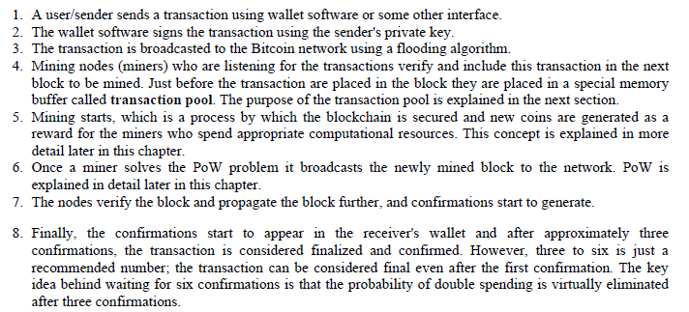
The transaction life cycle

Slide 17

Transaction fee
Transaction fees are charged by the miners
The fee charged is dependent upon the size and weight of the transaction
Transaction fees are calculated by subtracting the sum of the inputs and the sum of the outputs
https://buybitcoinworldwide.com/fee-calculator/
https://privacypros.io/tools/bitcoin-fee-estimator/

Slide 18
The fees are used as an incentive for miners to encourage them to include a user transaction in the block the miners are creating.
All transactions end up in the memory pool, from where miners pick up transactions based on their priority to include them in the proposed block.
Fees are not fixed by the Bitcoin protocol, if you pay a higher fee then your transaction is more likely to be picked by miners first due to additional incentive of the higher fee.

Slide 19
Transaction pools/ memory pools
these pools are basically created in local memory (computer RAM) by nodes in order to maintain a temporary list of transactions that are not yet confirmed in a block
Transactions are included in a block after passing verification and based on their priority

Slide 20
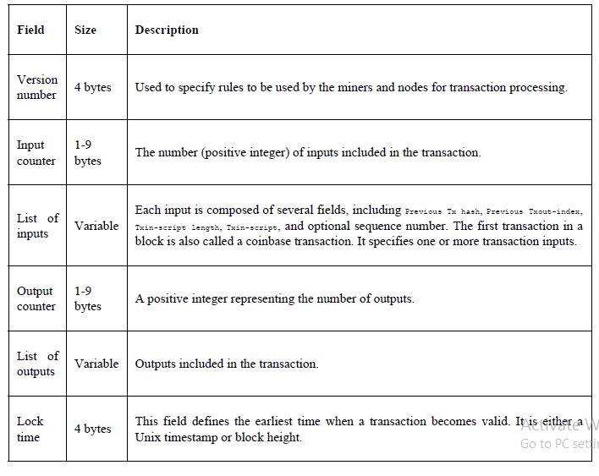
Transaction data structure

Slide 21
Metadata-contains some values such as the size of the transaction, the number of inputs and outputs, the hash of the transaction, and a lock_time field
Inputs- each input spends a previous output. Each output is considered as Unspent Transaction Output (UTXO) until an input consumes it. UTXO can be spent as an input to a new transaction
Verification- Verification is performed using Bitcoin's scripting language

Slide 22
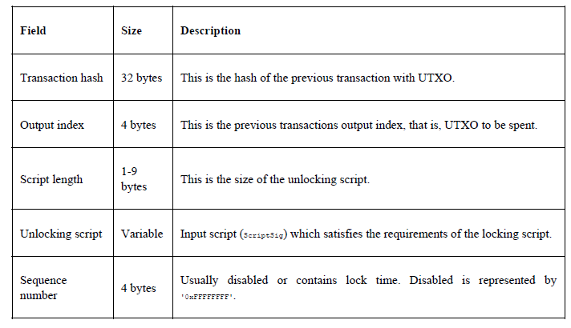
Transaction input data structure

Slide 23
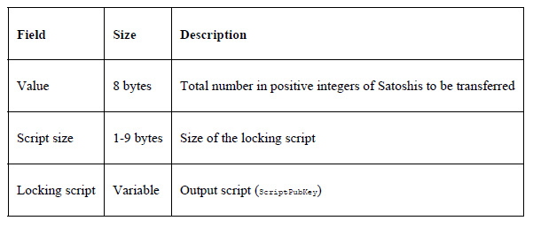
Transaction output data structure

Slide 24
The script language
Bitcoin uses a simple stack-based language called script to describe how bitcoins can be spent and transferred
It is not Turing complete and has no loops to avoid any undesirable effects of long-running/hung scripts on the Bitcoin network
Scripts use various opcodes or instructions to define their operation. Opcodes are also known as words,commands, or functions

Slide 25
A transaction script is evaluated by combining ScriptSig and ScriptPubKey. ScriptSig is the unlocking script, whereas ScriptPubKey is the locking script. This is how a transaction to be spent is evaluated:
1. First, it is unlocked and then it is spent
2. ScriptSig is provided by the user who wishes to unlock the transaction
3. ScriptPubkey is part of the transaction output and specifies the conditions that need to be fulfilled in order to spend the output
4. In other words, outputs are locked by ScriptPubKey that contains the conditions, when met will unlock the output, and coins can then be redeemed

Slide 26
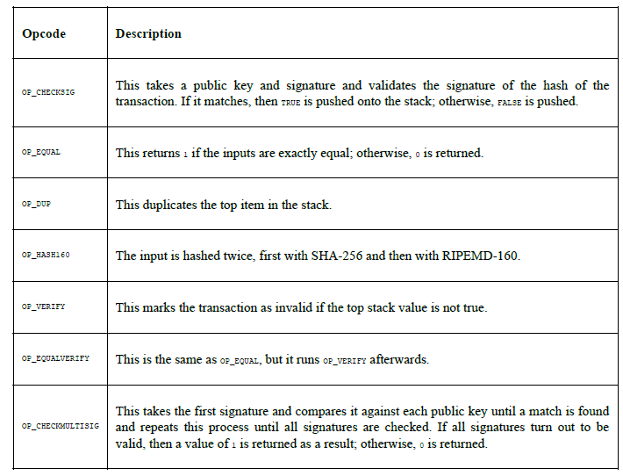
Commonly used opcodes

Slide 27
Types of transactions
Standard transactions are evaluated using IsStandard() and IsStandardTx() tests and only standard transactions that pass the test are generally allowed to be mined or broadcasted on the Bitcoin network.
Pay to Public Key Hash (P2PKH): P2PKH is the most commonly used transaction type and is used to send transactions to the bitcoin addresses.
Pay to Script Hash (P2SH): P2SH is used in order to send transactions to a script hash (that is, the addresses starting with 3) and was standardized in BIP16.
Null data/OP_RETURN: This script is used to store arbitrary data on the blockchain for a fee. The limit of the message is 40 bytes.

Slide 28
MultiSig (Pay to MultiSig)
M-of-N MultiSig transaction script is a complex type of script where it is possible to construct a script that required multiple signatures to be valid in order to redeem a transaction.
Various complex transactions such as escrow and deposits can be built using this script.
Pay to Pubkey:
This script is a very simple script that is commonly used in coinbase transactions. It is now obsolete and was used in an old version of bitcoin.
The public key is stored within the script in this case, and the unlocking script is required to sign the transaction with the private key.

Slide 29
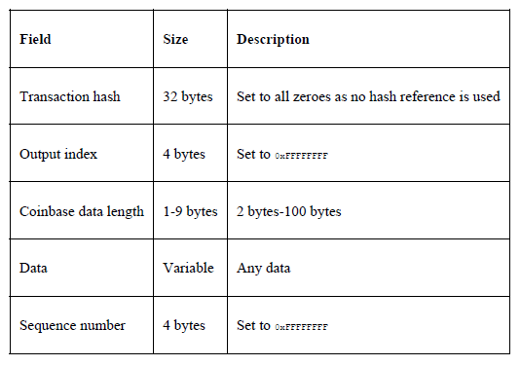
Coinbase transactions
A coinbase transaction or generation transaction is always created by a miner and is the first transaction in a block.
It is used to create new coins.
It includes a special field, also called coinbase, which acts as an input to the coinbase transaction.

Slide 30
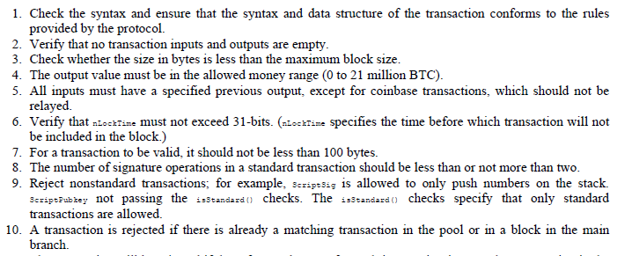
Transaction verification

Slide 31
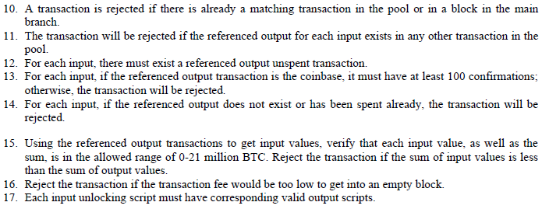
Transaction verification

Slide 32
Transaction malleability
Transaction malleability in Bitcoin was introduced due to a bug in the bitcoin implementation
this bug allows the changing of the unique ID of a Bitcoin transaction before it is confirmed
If the ID is changed before confirmation, it would seem that the transaction did not occur at all which can then allow these attacks

Slide 33
Blockchain
Blockchain is a public ledger of a timestamped, ordered, and immutable list of all transactions
Each block is identified by a hash in the chain and is linked to its previous block by referencing the previous block's hash

Slide 34
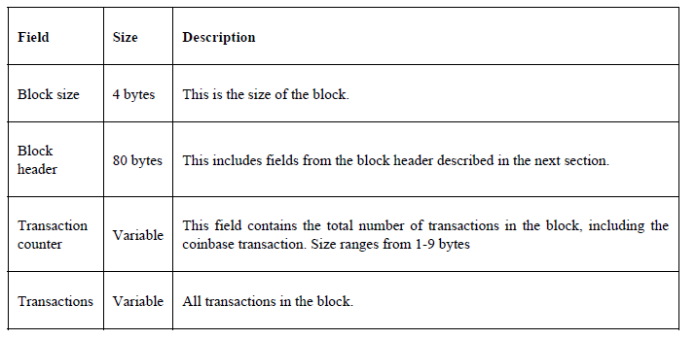
The structure of a block

Slide 35
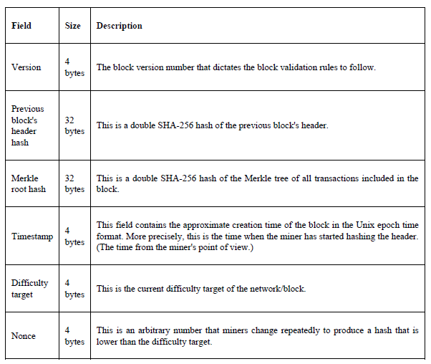
The structure of a block header

Slide 36
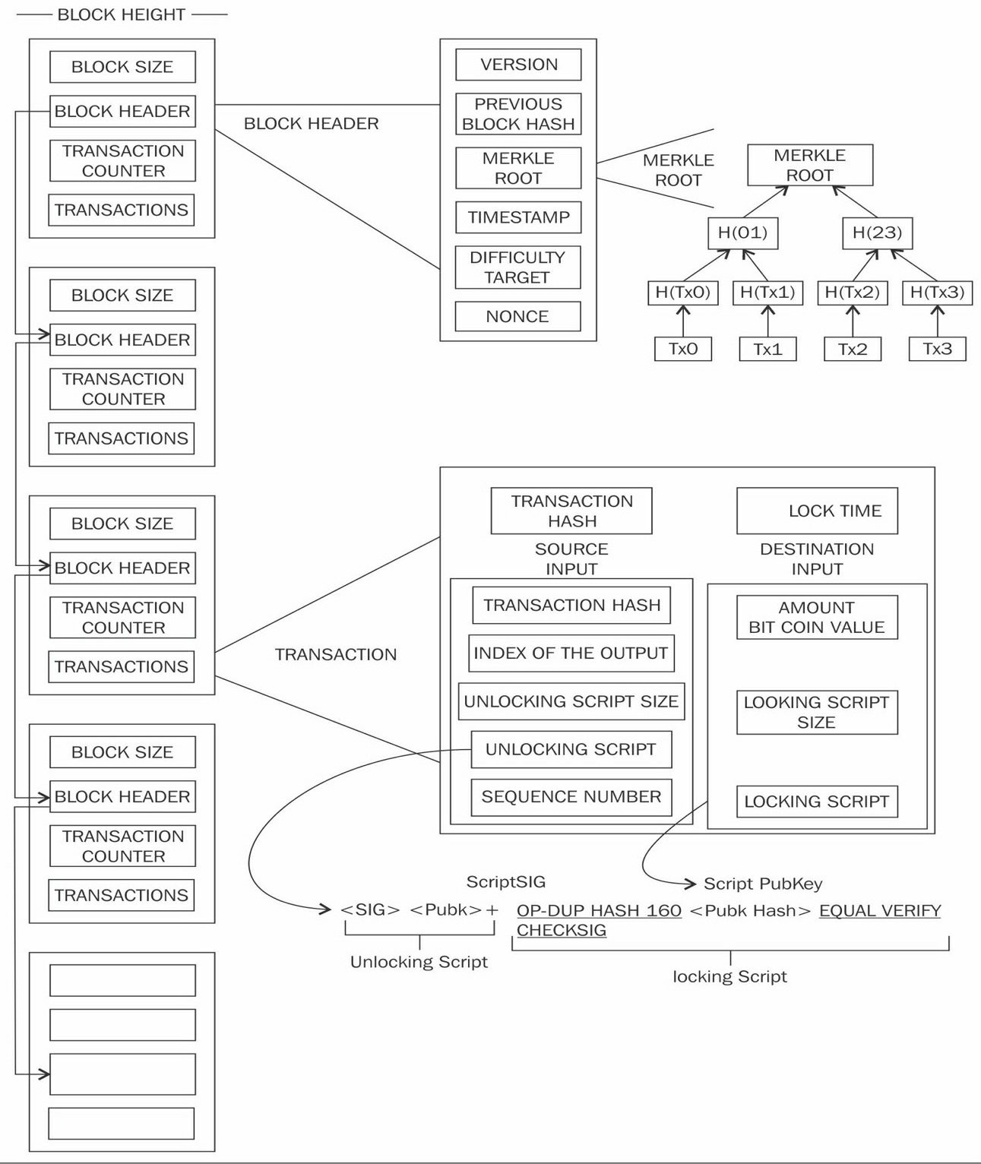
A visualization of the blockchain, block, block header, transactions and scripts

Slide 37
The genesis block
the first block in the Bitcoin blockchain
Bitcoin provides protection against double spending by enforcing strict rules on transaction verification and via mining
Block height is the number of blocks before a particular block in the blockchain
PoW is used to secure the blockchain
Bitcoin’s genesis block (https://github.com/bitcoin/bitcoin/blob/master/src/chainparams.cpp)

Slide 38
Stale blocks are created when a block is solved and every other miner who is still working to find a solution to the hash puzzle is working on that block
Orphan blocks are also called detached blocks and were accepted at one point in time by the network as valid blocks , rejected when a proven longer chain was created that did not include this initially accepted block.
They are not part of the main chain and can occur at times when two miners manage to produce the blocks at the same time.

Slide 39
Forks- In cases where two nodes simultaneously announce a valid block can result in a situation where there are two blockchains with different transactions
addressed by the Bitcoin network only by accepting the longest chain, the smaller chain will be considered orphaned
Forks in blockchain can also occur with the introduction of changes in the Bitcoin protocol.

Slide 40
Soft fork
a client which chooses not to upgrade to the latest version supporting the updated protocol will still be able to work and operate normally
previous and new blocks are both acceptable, thus making soft fork backwards compatible
only miners are required to upgrade to the new client software in order to make use of the new protocol rules
Hard fork
invalidates previously valid blocks and requires all users to upgrade

Slide 41
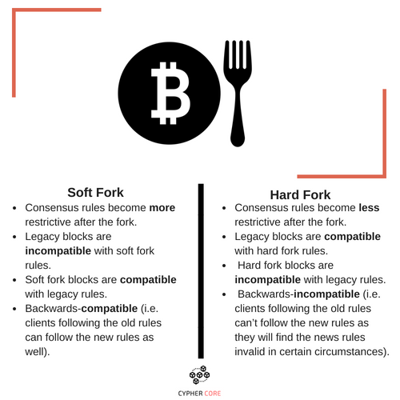

Slide 42
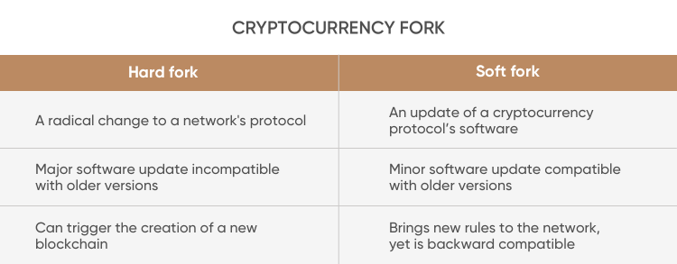

Slide 43

New blocks are added to the blockchain approximately every 10 minutes
network difficulty is adjusted dynamically every 2016 blocks in order to maintain a steady addition of new blocks to the network

Slide 44
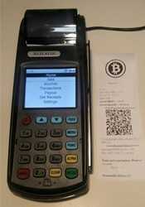
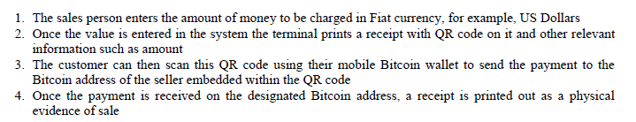
Bitcoin payments
Various payment solutions, such as XBTerminal and 34 Bytes bitcoin Point of Sale (POS) terminal are available commercially.

Slide 45
Bitcoin Improvement Proposals (BIPs) - to introduce and standardize bitcoin payments.
BIP 70 (Payment Protocol)-protocol for secure communication between a merchant and customers.
uses X.509 certificates for authentication and runs over HTTP and HTTPS
There are three messages in this protocol: PaymentRequest, Payment, and PaymentACK
key features of this proposal - defense against man-in-the-middle attacks and secure proof of payment
other BIPs -BIP 71 (Payment Protocol MIME types) and BIP 72 (URI extensions for Payment Protocol)

Slide 46
Alternative Coins
Bitcoin was released in 2009, and the first alternative coin project (named Namecoin) was introduced in 2011.
In 2013 and 2014, the alternative coins (altcoin) market grew exponentially,
Alternative approaches to bitcoin can be divided broadly into two categories, based on the primary purpose of their development-,
If the primary goal is to build a decentralized blockchain platform, they are called alternative chains
if the sole purpose of the alternative project is to introduce a new virtual currency, it is called an altcoin

Slide 47
Zcash is a more successful altcoin introduced in 2016
Primecoin did not gain much popularity however it is still used.
Many of these alternative projects are direct forks of Bitcoin source code although some of those have been written from scratch.
an altcoin is generated in the case of a hard fork.
hard fork caused a new currency Ethereum Classic (ETC) to come into existence in addition to the Ethereum (ETH) currency.

Slide 48
Theoretical foundations
Alternatives to Proof of Work
PoW is the primary vehicle in Bitcoin for providing decentralized distributed consensus.
PoW schemes are required to have a much-desired property called progress freeness, which means that the reward for consuming computational resources should be random and proportional to the contribution made by the miners

Slide 49
Other requirements for mining computational puzzles
Adjustable difficulty ensures that the difficulty target for mining on the blockchain is regulated in response to increased hashing power and the number of users.
Quick verification is a property which means that mining computational puzzles should be easy and quick to verify.

Slide 50
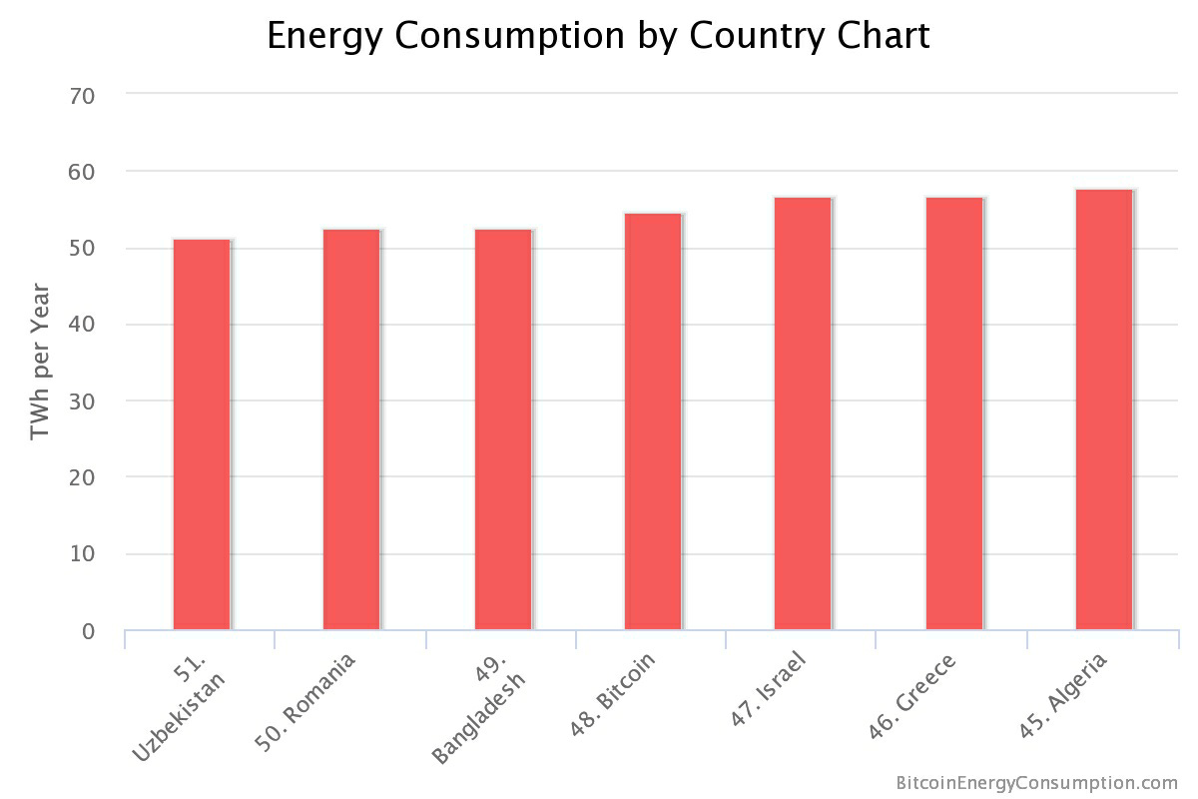

Slide 51
Proof of Storage
Also known as proof of retrievability
requires storage of a large amount of data
Miners are required to store a pseudo, randomly-selected subset of large data to perform mining

Slide 52
Proof of Stake (PoS) (virtual mining)
first proposed in Peercoin in August 2012
The users are required to demonstrate possession of a certain amount of currency (coins) thus proving that they have a stake in the coin.
The benefits of this scheme are twofold;
first acquiring large amounts of digital currency is relatively difficult as compared to buying high-end ASIC devices and
second it results in saving computational resources.

Slide 53
Various stake types
Proof of coinage
Proof of Deposit (PoD)
Proof of Burn
Proof of Activity (PoA)
Nonoutsourceable puzzles

Slide 54
Difficulty adjustment and retargeting algorithms
generation of 2016 blocks should take roughly around two weeks
longer than two weeks to mine 2016 blocks- Difficulty decreases
shorter than two weeks to mine 2016 blocks- Difficulty increases
ASIC is introduced, difficulty increases exponentially → mining power centralization
An application-specific integrated circuit (ASIC) is generally optimized to compute just a single function or set of related functions.

Slide 55
if a new coin starts now with the same PoW based on SHA-256 as bitcoin uses, then it would be easy for a malicious user to just simply use an ASIC miner and control the entire network.
multipools pose a more significant threat where a group of miners can automatically switch to the currency that is becoming profitable (known as pool hopping)

Slide 56
Kimoto Gravity Well
first introduced in Megacoin
used to adjust the difficulty of the network every block adaptively
ensures that the time between blocks remains approximately the same.
In Bitcoin, the difficulty is adjusted every 2016 blocks, but in KGW the difficulty is adjusted at every block.
vulnerable to time warp attacks, which, allow an attacker to enjoy less difficulty in creating new blocks temporarily.
This attack allows a time window where the difficulty becomes low, and the attacker can quickly generate many coins at a fast rate.

Slide 57

Dark Gravity Wave
first introduced in Dash, previously known as Darkcoin
address certain flaws such as the time warp attack
This formula is implemented in Dash coin, Bitcoin SegWit2X and various other altcoins as a mechanism to readjust difficulty.

Slide 58
DigiShield
works by going through a fixed number of previous blocks to calculate the time they took to be generated and then readjusts the difficulty

Slide 59
MIDAS (Multi-Interval Difficulty Adjustment System)
more complex than the algorithms discussed previously due to number of parameters it uses
responds much more rapidly to abrupt changes in hash rates
protects against time warp attacks

Slide 60
Bitcoin limitations
Privacy and anonymity
As the blockchain is a public ledger of all transactions and is openly available, it becomes trivial to analyze it.
Combined with traffic analyses, transactions can be linked back to their source IP addresses, thus possibly revealing a transaction's originator.
Various proposals have been made to address the privacy issue in Bitcoin. These proposals fall into three categories,
mixing protocols
third-party mixing networks
inherent anonymity

Slide 61
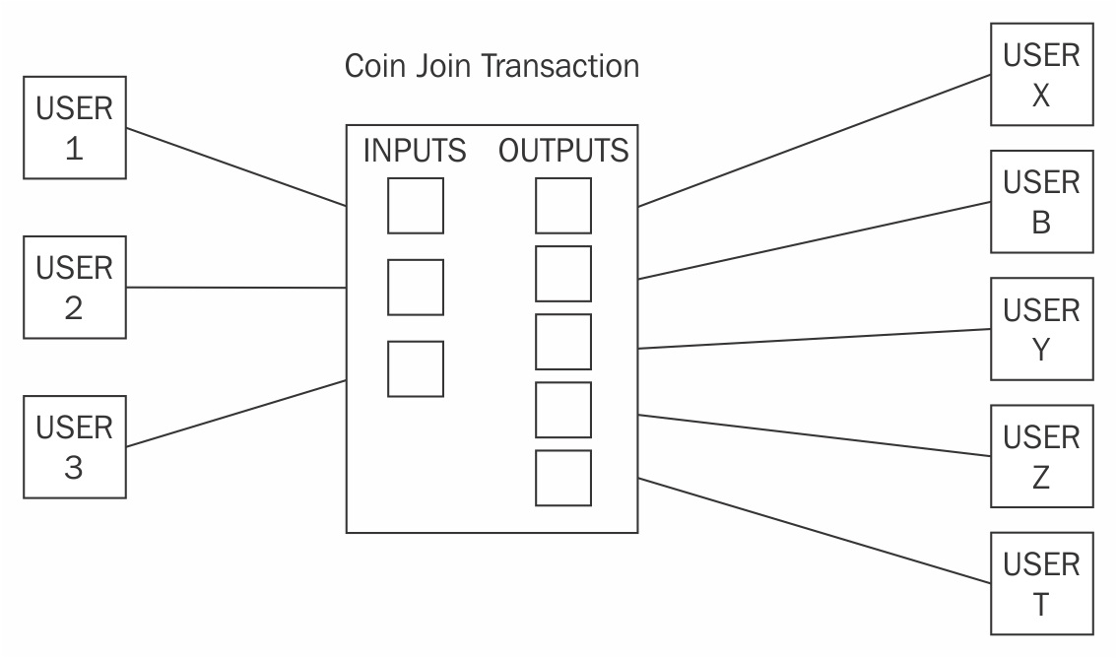
Mixing protocols
CoinJoin transaction with three users joining their transaction into a single larger CoinJoin transaction

Slide 62
a mixing service provider (an intermediary or a shared wallet) is used
Users send coins to this shared wallet as a deposit, and then, the shared wallet can send some other coins (of the same value deposited by some other users) to the destination.
Users can also receive coins that were sent by others via this intermediary.
This technique improves privacy for all participants involved in the transactions.

Slide 63
Third-party mixing protocols
Various third-party mixing services are available, but if the service is centralized, then it poses the threat of tracing the mapping between senders and receivers because the mixing service knows about all inputs and outputs.
pose the risk of the administrators of the service stealing the coins.
Various services, with varying degrees of complexity, such as CoinShuffle, Coinmux, and Darksend in Dash (coin) are available

Slide 64
Inherent anonymity
coins that support privacy inherently and is built into the design of the currency
Zcash, which uses Zero-Knowledge Proofs (ZKP) to achieve anonymity
Monero, which makes use of ring signatures to provide anonymous services

Slide 65
Smart Contracts
Smart contracts were first theorized by Nick Szabo in the late 1990s in an article named Formalizing and Securing Relationships on Public Networks,
"A smart contract is an electronic transaction protocol that executes the terms of a contract. The general objectives are to satisfy common contractual conditions (such as payment terms, liens, confidentiality, and even enforcement), minimize exceptions both malicious and accidental, and minimize the need for trusted intermediaries. Related economic goals include lowering fraud loss, arbitrations and enforcement costs, and other transaction costs."
A smart contract is a secure and unstoppable computer program representing an agreement that is automatically executable and enforceable.

Slide 66
A smart contract has the following four properties:
Automatically executable
Enforceable
Semantically sound
Secure and unstoppable

Slide 67
Ricardian contracts
These contracts were used initially in a bond trading and payment system called Ricardo.
The fundamental idea is to write a document that is understandable and acceptable by both a court of law and computer software.
A Ricardian contract is a document that has several of the following properties:
A contract offered by an issuer to holders
A valuable right held by holders and managed by the issuer
Easily readable by people (like a contract on paper)
Readable by programs (parsable, like a database)
Digitally signed
Carries the keys and server information
Allied with a unique and secure identifier

Slide 68
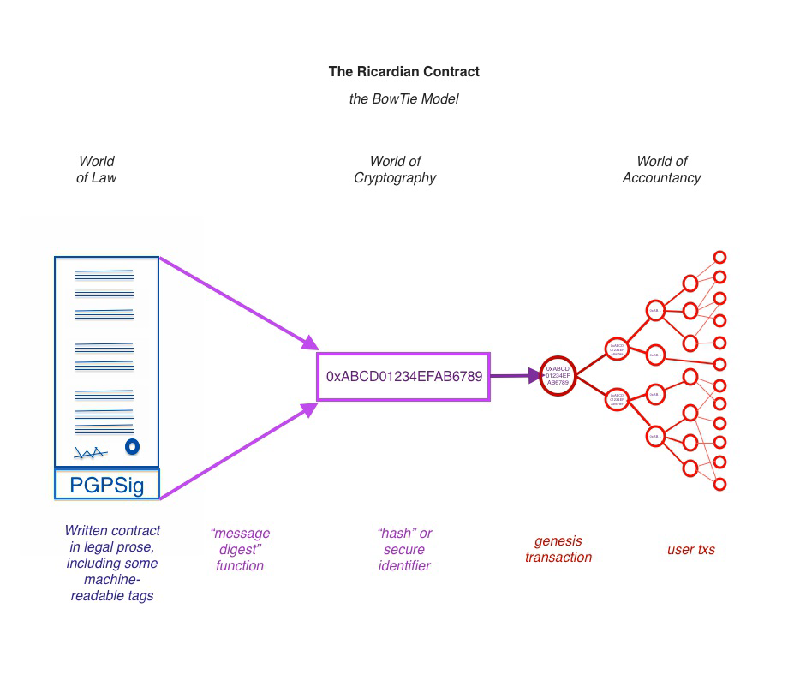

Slide 69
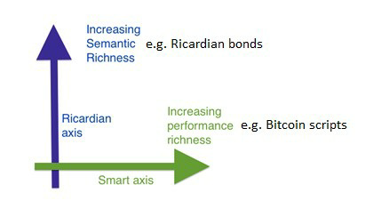
Diagram explaining performance versus semantics are orthogonal issues as described by Ian Grigg; slightly modified to show examples of different types of contracts on both axis

Slide 70
Oracles
The limitation with smart contracts is that they cannot access external data, which might be required to control the execution of the business logic;
Oracles can be used to provide external data to smart contracts.
An Oracle is an interface that delivers data from an external source to smart contracts.
Depending on the industry and requirements, Oracles can deliver different types of data ranging from weather reports, real-world news, and corporate actions to data coming from Internet of Things (IoT) devices.

Slide 71
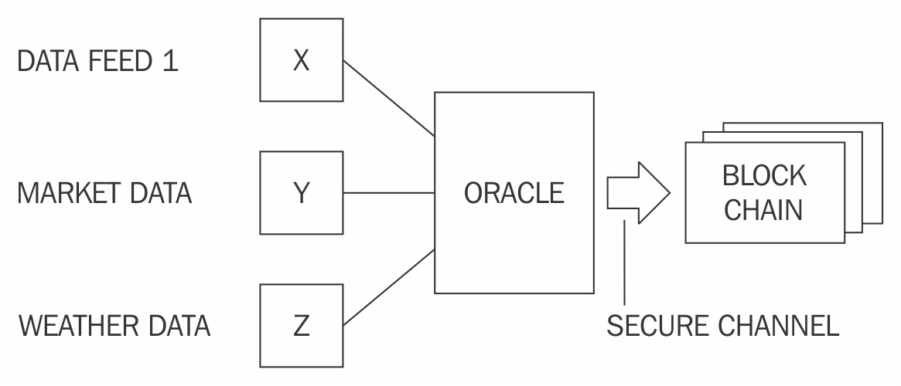
A generic model of an Oracle and smart contract ecosystem

